Slide 1




14 - 16 NOVEMBER 2023
RIYADH, SAUDI ARABIA
Blockchain Attack: Wreaking Havoc
Mirza Burhan Baig
Senior Security Consultant
Owais Mehtab
Principal Security Consultant, MDSec
ORGANISED BY:
IN ASSOCIATION WITH:

Slide 2


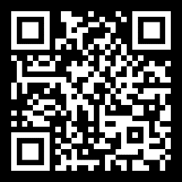
/Users/burhanbaig/@BHMEA> whoami
USER INFORMATION
------------------------------------
Mirza Burhan Baig – OSCP | eCIR | eCTHPv2 | eWPTX | eCPPTv2 | eNDP | cPTE | MCP | NCA
Threat Analyst | User Therapist
------------------------------------
Primary Research area includes
Red Teaming, Threat Hunting, IoT Security, Web Application, Mobile Application Security
------------------------------------
International Speaker at:
BlackHat – MEA, @Hack, LeHack, CactusCon, OWASP - Riyadh Chapter, BSides Islamabad, BSides SLC, etc.
------------------------------------
Acknowledged By
Google, Microsoft, Facebook, Amazon, PayPal, Apple, IBM, CISCO, etc.
------------------------------------
Worked For
Financial, Health, Business, Energy - utilities & Government Sectors

Slide 3

/Users/OwaisMehtab/@BHMEA> whoami
USER INFORMATION
------------------------------------
Owais Mehtab – CRTO | GREM | eCIR | OSWE | OSWP | Corelan Advanced | eCTHP | CRT | CEH | eWPTX | eCPTX
------------------------------------
Primary Research area includes
Web Application, Mobile Application, Infrastructure, Threat Hunting
------------------------------------
International Speaker at:
BlackHat – MEA, BSides Islamabad, BSides Edmonton, etc.
------------------------------------
Worked For
Financial, Health, Business, Energy - utilities & Government Sectors

Slide 4
What This Talk Is Not About
Crypto Exchange hacks
Phishing incidents for stealing seed phrases of wallets
Rug pull contracts
Notes:
A fallback function is a default function in a contract that is called when no other function is specified

Slide 5
Biggest Blockchain Hacks
(2022) - Nomad Token Bridge - $190 million
(2022) - Maiar - $113 million
(2020) - KuCoin - $285 million
(2018) - BitGrail - $170 million
(2017) - NiceHash - $64 million
(2016) - Bitfinex - $72 million
(2014) - Mt. Gox - $480 million

Slide 6
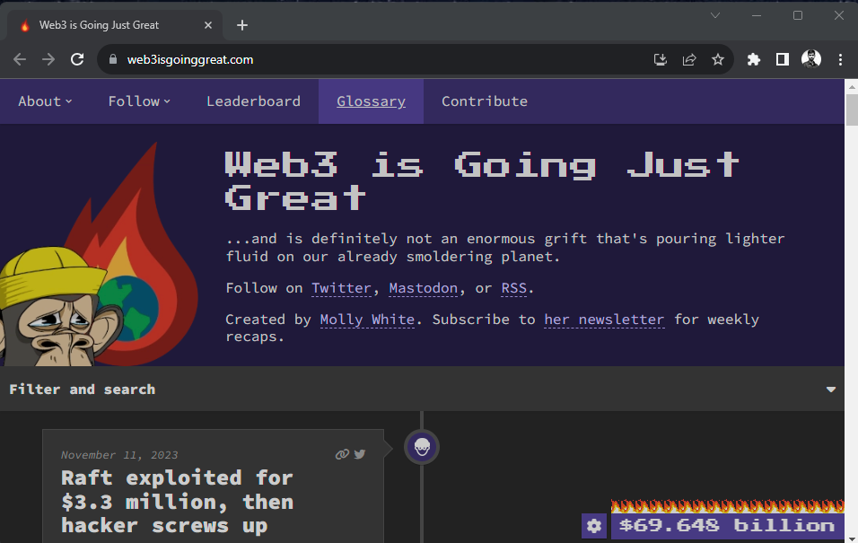
Total Amount Lost

Slide 7
The 1st Bitcoin Incident
Occurred in August 2010
A person known as SmokeTooMuch
Exploited a integer overflow bug in the Bitcoin protocol
Creation of huge number (over 92 billion) of Bitcoins sent to 2 addresses.

Slide 8
What Is Smart Contract
A program/protocol that is intended to automatically execute, control or document events and action to the terms of contract or an agreement
Or
An open distribute ledger that records transactions between parties

Slide 9
Smart Contract Basic Attributes
Decentralized
Reduces single point of failure
Immutable
Once deployed nobody can change the terms
Transparent
Open to everyone

Slide 10
Smart Contract Applications
Finance
Supply Chain Management
Real Estate
Legal Industry
Gaming
Voting

Slide 11

Smart Contract Challenges
Had to implement changes
What if a bug was identified in deployed version of the contract ?
Gas Cost
Writing efficient code is challenging, unoptimized code can cause high gas rates.
Security ?

Slide 12
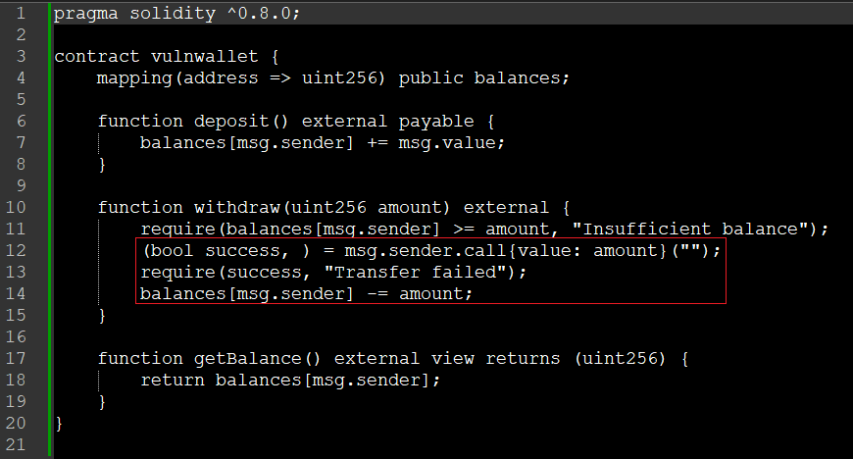
Reentrancy Attack
Description
Vulnerable Code
An external contract can call the vulnerable function repeatedly before the target contract can change it’s state by calling the fallback function.
Vulnerable patterns
https://github.com/uni-due-syssec/eth-reentrancy-attack-patterns
Notes:
A fallback function is a default function in a contract that is called when no other function is specified

Slide 13
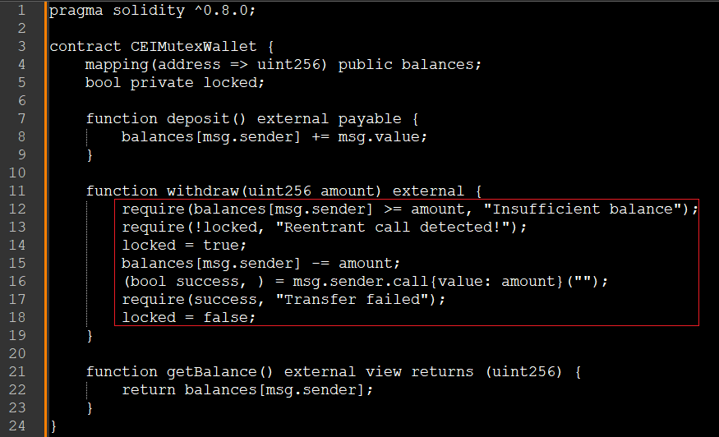
Reentrancy Attack
How to Secure
Fixed Code
Check Effects Interaction
First perform any checks at the start of the function.
Resolve all the effects to the state of the contract.
Only after all state changes are resolved should the function interact with other contracts
Use mutex
Use Reentrancy guard/modifiers – does not prevent against cross contract reentrancy attacks

Slide 14
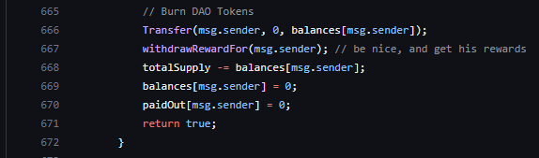
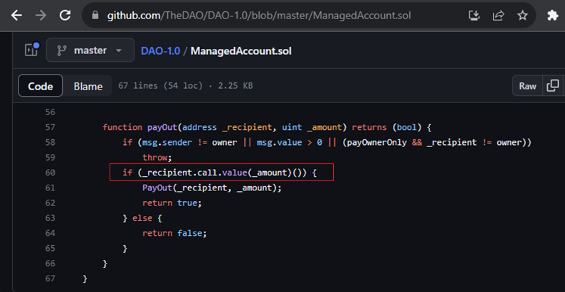
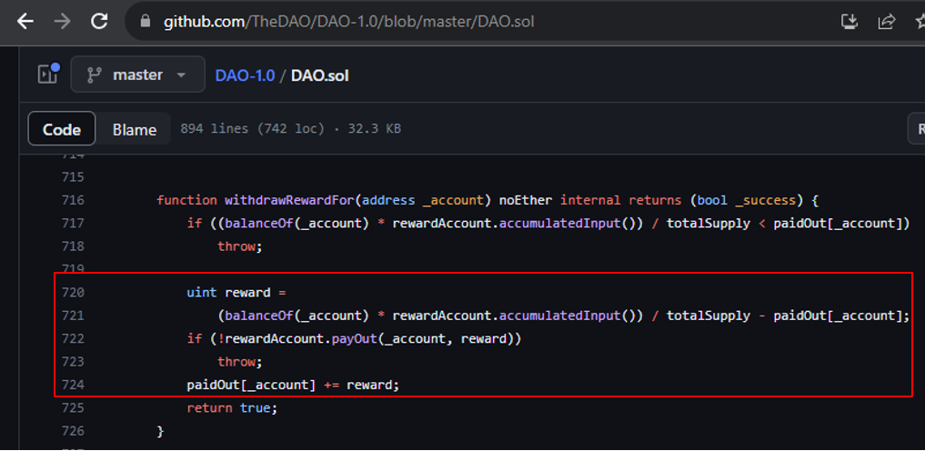
Reentrancy Attack
Real World Example
The DAO Hack https://github.com/TheDAO/DAO-1.0/blob/master/DAO.sol
Costed about 3.6 million ETH
Full details: https://hackingdistributed.com/2016/06/18/analysis-of-the-dao-exploit/
The split function was used to split ethers if a user want to claim back tokens, it called withdrawRewardFor method which eventually called PayOut method
Classic checks-effects-interaction mistake!
Notes:
https://hackingdistributed.com/2016/06/18/analysis-of-the-dao-exploit/

Slide 15
Reentrancy Attack
Real World Example
The Sentiment Platform https://www.sentiment.xyz/
Costed about 1 million USD (April 2023) although the sentiment team was able to recover it
https://beincrypto-com.webpkgcache.com/doc/-/s/beincrypto.com/defi-lending-platform-sentiment-loses-1m-exploit/
List of all reentrancy attacks
https://github.com/pcaversaccio/reentrancy-attacks
Notes:
https://hackingdistributed.com/2016/06/18/analysis-of-the-dao-exploit/

Slide 16
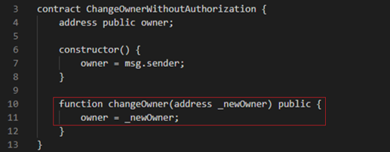
Authorization Attack
Description
Vulnerable Code
Exposing sensitive operation/function without checking the rights of caller.
Can anyone invoke a function that they should not have the permission to ?

Slide 17
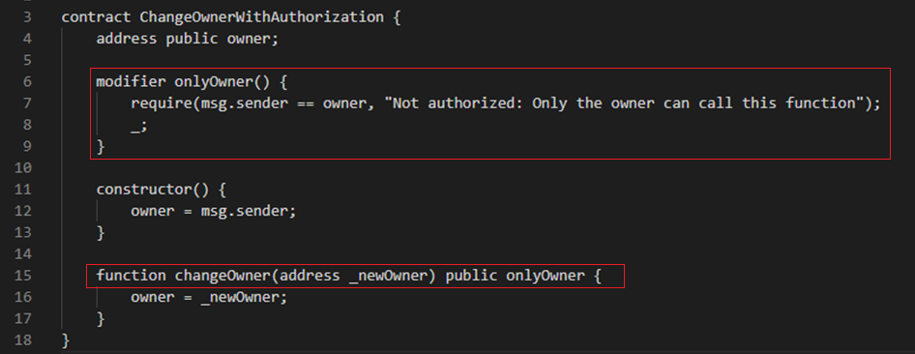
Authorization Attack
How to Secure
Fixed Code
Implement authorization
Check if the caller has right to execute or perform requested actions
Use proper modifiers

Slide 18
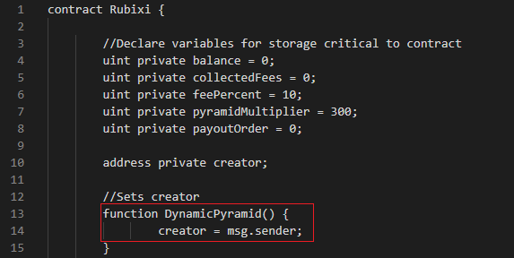
Authorization Attack
Real World Example
Rubixi wallet
https://etherscan.io/address/0xe82719202e5965Cf5D9B6673B7503a3b92DE20be#code
Parity wallet
Costed around 150K ETH

Slide 19
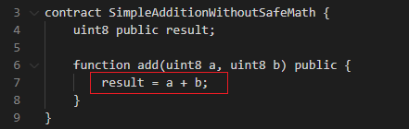
Arithmetic OverFlows
Description
Vulnerable Code
User supplied data either adds to or subtracts beyond the limits the variable type can hold.
The overflowed data would then go on and change value of other variables or memory mapping resulting in exceedingly large values
Any uint8 variable can hold value from 0 to 255
a= 100; b=155; result =255
a= 101; b=155; result = 0
0110 0100
+ 1001 1011
-----------------
1111 1111
0110 0101
+ 1001 1011
------------------
1 0000 0000

Slide 20
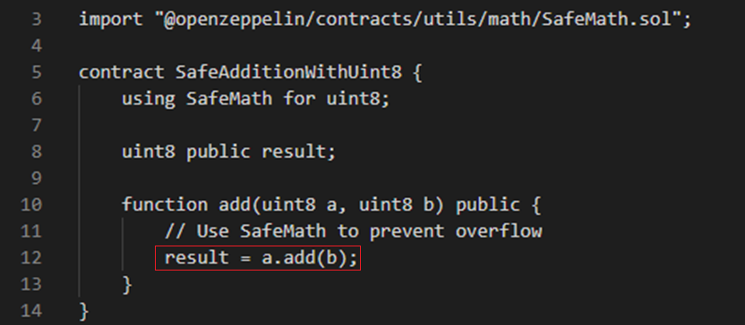
Arithmetic OverFlows
How to Secure
Fixed Code
Use safemath library for arithmetic operations
Compile contracts on newer version of solidity

Slide 21
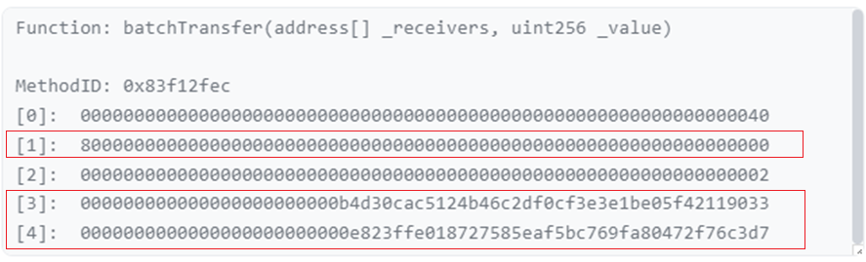
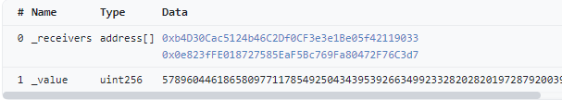
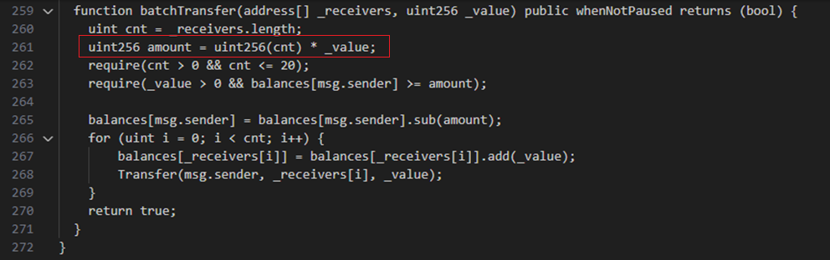
Arithmetic OverFlows
Real World Example
BEC Chain
https://etherscan.io/tx/0xad89ff16fd1ebe3a0a7cf4ed282302c06626c1af33221ebe0d3a470aba4a660f

Slide 22
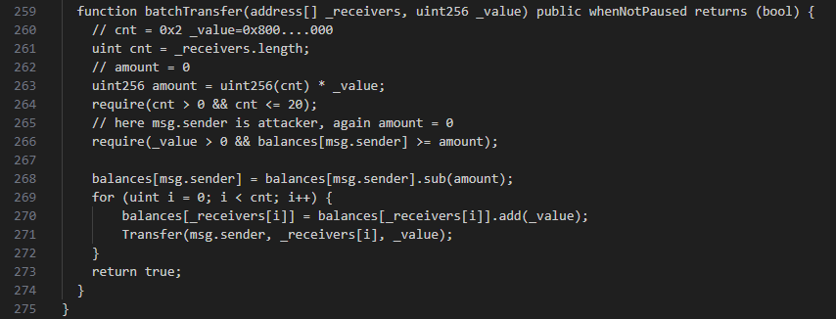
Arithmetic OverFlows
Real World Example
cnt = 2

Slide 23
Arithmetic OverFlows
Real World Example
Uint256_max:
0xffffffffffffffffffffffffffffffffffffffffffffffffffffffffffffffff
cnt = 2
amount = 0
_value:
0x8000000000000000000000000000000000000000000000000000000000000000
cnt:
0x2
amount = cnt * _value:
0x10000000000000000000000000000000000000000000000000000000000000000

Slide 24
Arithmetic OverFlows
Real World Example
Uint256_max:
0xffffffffffffffffffffffffffffffffffffffffffffffffffffffffffffffff
cnt = 2
amount = 0
_value:
0x8000000000000000000000000000000000000000000000000000000000000000
cnt:
0x2
amount = cnt * _value:
0x10000000000000000000000000000000000000000000000000000000000000000

Slide 25
Arithmetic OverFlows
Real World Example
Uint256_max:
0xffffffffffffffffffffffffffffffffffffffffffffffffffffffffffffffff
cnt = 2
amount = 0
_value:
0x8000000000000000000000000000000000000000000000000000000000000000
cnt:
0x2
amount = cnt * _value:
0x10000000000000000000000000000000000000000000000000000000000000000

Slide 26
Arithmetic OverFlows
Real World Example
Uint256_max:
0xffffffffffffffffffffffffffffffffffffffffffffffffffffffffffffffff
cnt = 2
amount = 0
_value:
0x8000000000000000000000000000000000000000000000000000000000000000
cnt:
0x2
amount = cnt * _value:
0x10000000000000000000000000000000000000000000000000000000000000000

Slide 27
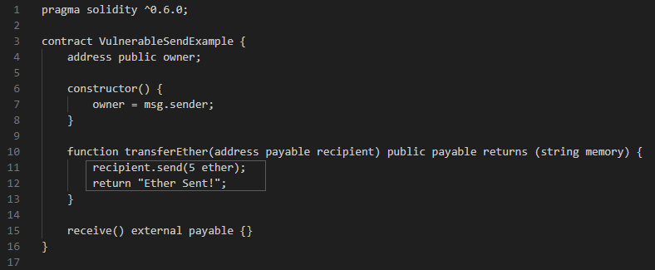
Unchecked Use of Low Level Calls
Vulnerable Code
Description
Use of low level functions without proper checks such as call(), callcode(), delegatecall() and send()
These functions only return a Boolean value and does not revert/halt code execution if exception occurs

Slide 28
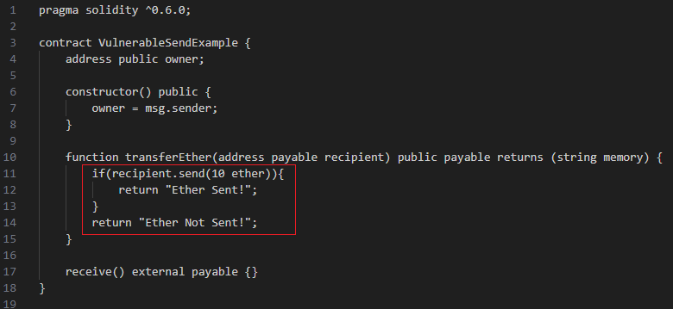
Unchecked Use of Low Level Calls
How to Secure
Fixed Code
Always perform checks on return value of low level calls
Break/revert execution of code of the expected value is not returned e.g., false
Where possible use transfer() instead of send()

Slide 29
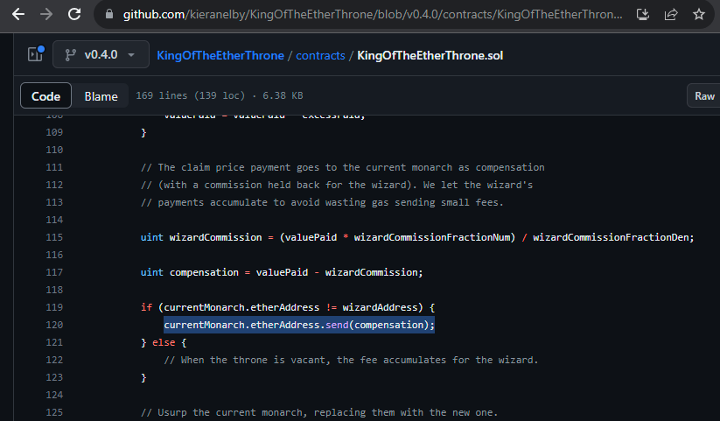
Unchecked Use of Low Level Calls
Real World Example
King of the Ether
https://github.com/kieranelby/KingOfTheEtherThrone/blob/v0.4.0/contracts/KingOfTheEtherThrone.sol
For complete details: https://www.kingoftheether.com/postmortem.html
The contract did not check the value of send()
As a result when a new user could become the king Even though the previous king had not received the compensation due to gas issues
Notes:
Suppose the current claim price for the throne is 10 ether.
You want to be King/Queen, so you send 10 ether to the contract.
The contract sends your 10 ether (less a 1% commission) to the previous King/Queen, as a "compensation payment".
The contract makes you the new King/Queen of the Ether Throne.
The new claim price for the throne goes up by 50%, to 15 ether in this case.
If an usurper comes along who is willing to pay 15 ether, they depose you and become King/Queen, and you receive their payment of 15 ether as your "compensation payment".
When the King of the Ether Throne contract sent a payment to a "contract account", it inadvertently included only a small amount of gas with the payment - 2300 gas.
This was not enough gas for an Ethereum Mist "contract-based wallet" contract to successfully process a payment - instead the wallet contract failed.
When a wallet contract failed to process the payment sent to it by the contract, the ether paid was returned to the contract. The contract was not aware that the payment had failed and it continued processing, making the caller King despite the compensation payment not having been sent to the previous monarch.

Slide 30
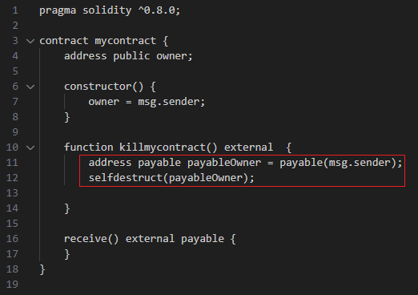
Denial Of Service
Vulnerable Code
Description
A contract once taken down can never be recovered
Can be cause by various reasons of logic and ACL issues

Slide 31
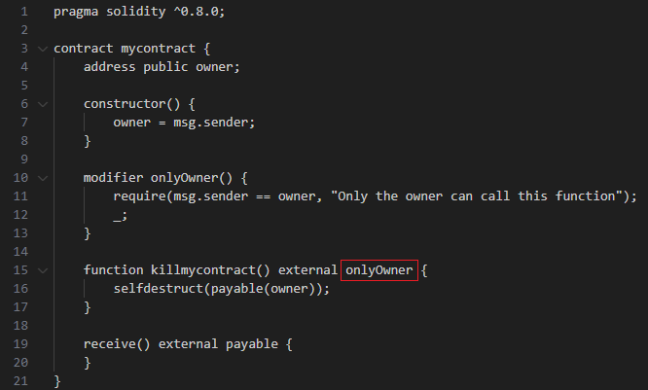
Denial Of Service
How to Secure
Fixed Code
Get your code audited
Ensure sensitive functions are properly protected
Dry run code on testnet to identify any potential unexpected code flow that can cause DOS

Slide 32
Denial Of Service
Real World Example
Parity wallet again !
Estimated loss over 513000 ether (locked forever)
I accidently killed it
https://github.com/openethereum/parity-ethereum/issues/6995

Slide 33
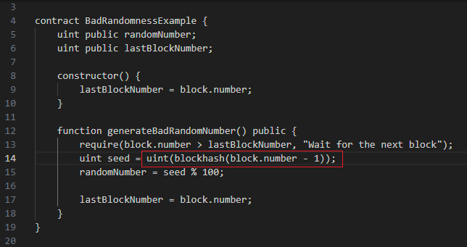
Randomness Issue
Vulnerable Code
Description
Use block number or timestamp as block hash
Use of timestamp is bad idea as it can be manipulated by miners
If a block is older than 256 blocks it will always return 0
Notes:
Reference: https://github.com/cclabsInc/BlockChainExploitation/blob/master/2020_BlockchainFreeCourse/bad_randomness/vulnerableBlockHashGame.sol

Slide 34
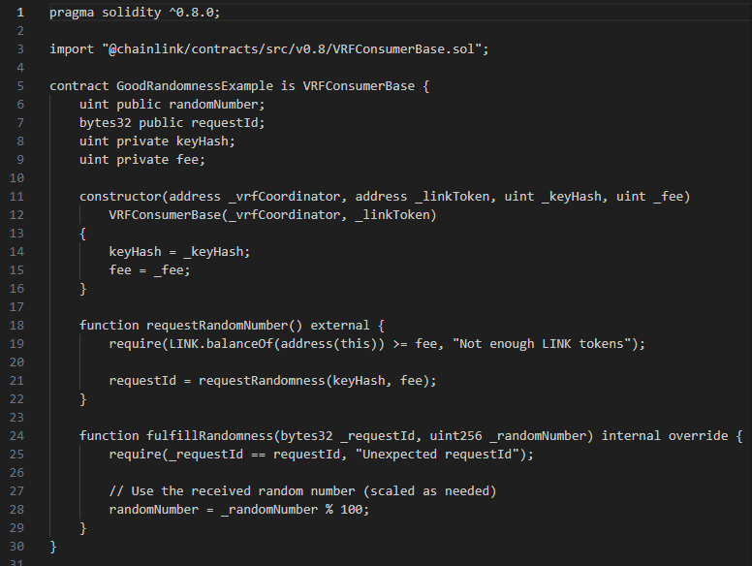
Randomness Issue
How to Secure
Fixed Code
Use Chainlink Verifiable Random Function
External service that provides secure and verifiable randomness
Use external oracle
Similar service that provides external data, including randomness
Commit reveal scheme
Participants commit to a value, reveal it later, and the randomness is derived from the combination of revealed values.

Slide 35
Randomness Issue
Real World Example
SmartBillions lottery
A person betted on value then waited for over 256 blocks to simply with the lottery
Estimated loss over 400 ether
Full Details
https://www.reddit.com/r/ethereum/comments/74d3dc/smartbillions_lottery_contract_just_got_hacked/

Slide 36
Key Takeaway
Use latest compiler
Input validation (e.g., type & range)
Visibility & Access control
Checks-Effects-Interactions
Use chainlink VRF or other secure randomness sources
Code Audit
Use safe, known and reputed oracles
Error handling and checking low level function calls value
Gas limits

Slide 37
Learning Resources
The Ethernaut
https://ethernaut.openzeppelin.com/
Damn Vulnerable Defi
https://www.damnvulnerabledefi.xyz/
Not-so-smart-contracts
https://github.com/crytic/not-so-smart-contracts
Console Cow Boys Blog
https://console-cowboys.blogspot.com/
Dapp University
https://www.dappuniversity.com/
Publicly available contract audit reports
https://github.com/interfinetwork/smart-contract-audits
Security Requirements For Development
https://entethalliance.org/specs/ethtrust-sl/

Slide 38
Auditing Tools
Slither
https://github.com/crytic/slither
Mythril
https://github.com/ConsenSys/mythril
MadMax
https://github.com/nevillegrech/MadMax
Oyente
https://github.com/enzymefinance/oyente
Manticore
https://github.com/trailofbits/manticore
Slither
https://github.com/crytic/slither
Various Repositories for Smart Contract
https://github.com/shanzson/Smart-Contract-Auditor-Tools-and-Techniques

Slide 39
Thank You!

